Slide 1





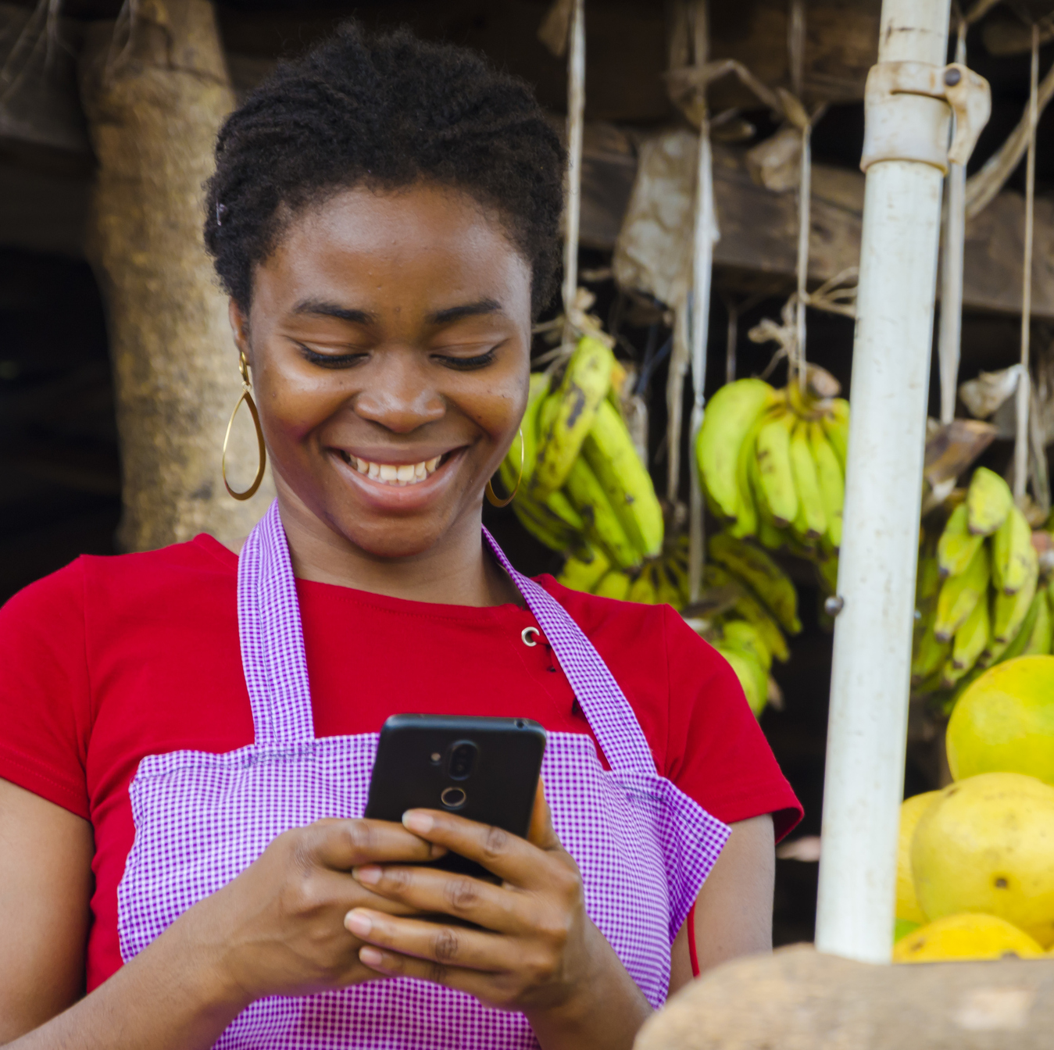

Happy
Birthday
Wikipedia

Slide 2

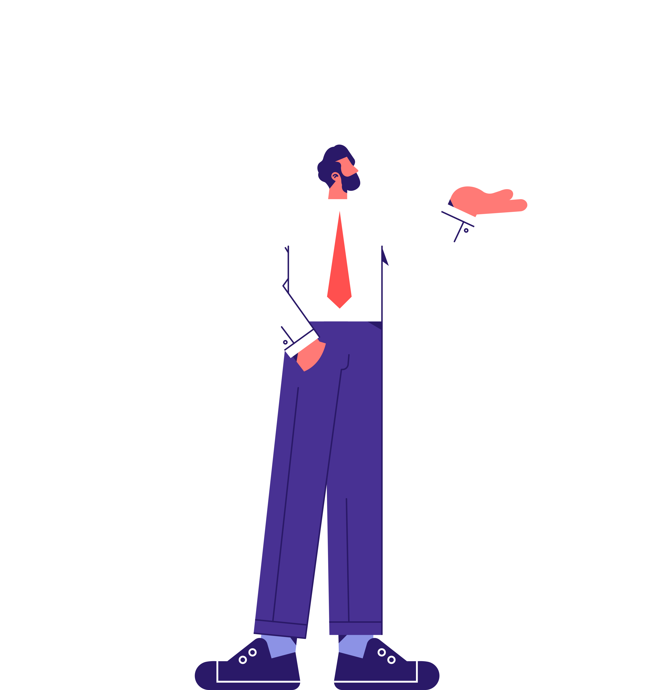
Learning Objectives
To understand what Wikipedia is.
To work out what’s true and what’s false about Wikipedia.
To explore what a neutral point of view is.
To explore what makes a reliable source.
To understand how Wikipedia differs from other sources of information online.

Slide 3



What do you know about Wikipedia?
Discuss…
Have you ever used Wikipedia?
If you have used Wikipedia you trust what you read?
Why / why not?
Have you ever been told not to use Wikipedia?
How do you think Wikipedia is created?

Slide 4

What is Wikimedia UK?
Learn…
Wikimedia UK works in partnership with organisations in the cultural, education and other sectors to make open knowledge accessible to all, and remove barriers to accessing open knowledge.
Our work focuses on knowledge and communities that have been left out by structures of power and privilege, helping to eradicate inequality and bias on the Wikimedia projects.
We work to improve media literacy across society, equipping people to not only access information but to be able to critically evaluate what they find online.

Slide 5

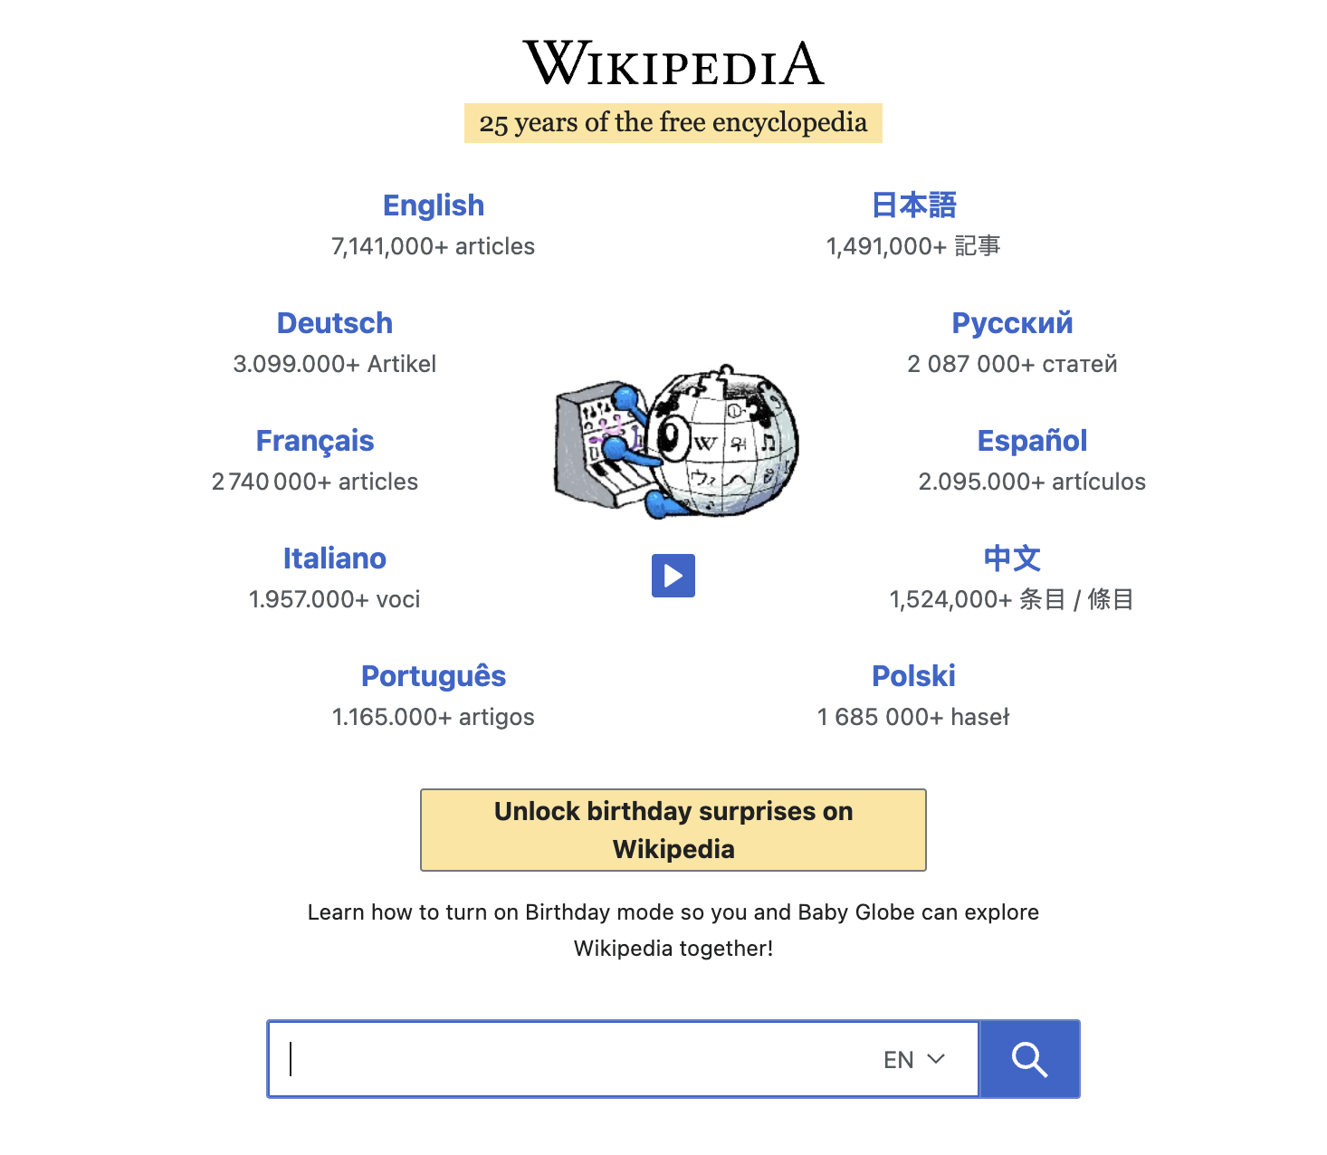



Slide 6
What is Wikipedia?
Learn…
Wikipedia is a free, online encyclopedia written and maintained by a community of volunteers known as Wikimedians. Wikipedia is a collaborative project, where anyone can contribute.
Wikipedia is the largest, most read reference work in history.
Wikipedia has over 500 million visitors and
18 billion page views per month.
You can edit articles by correcting errors, adding information or adding references. Or you could even write an article about something or someone that is not yet on Wikipedia. No-one owns a Wikipedia article, not even the person who created it.

Slide 7

How is Wikipedia
Created?
Learn…
Wikipedia is a collaborative project, where anyone can contribute.
Wikipedia is a free, online encyclopedia written and maintained by a community of volunteers known as Wikimedians.
You can edit articles by correcting errors, adding information or adding references. Or you could even write an article about something or someone that is not yet on Wikipedia.
No-one owns a Wikipedia article, not even the person who created it.

Slide 8
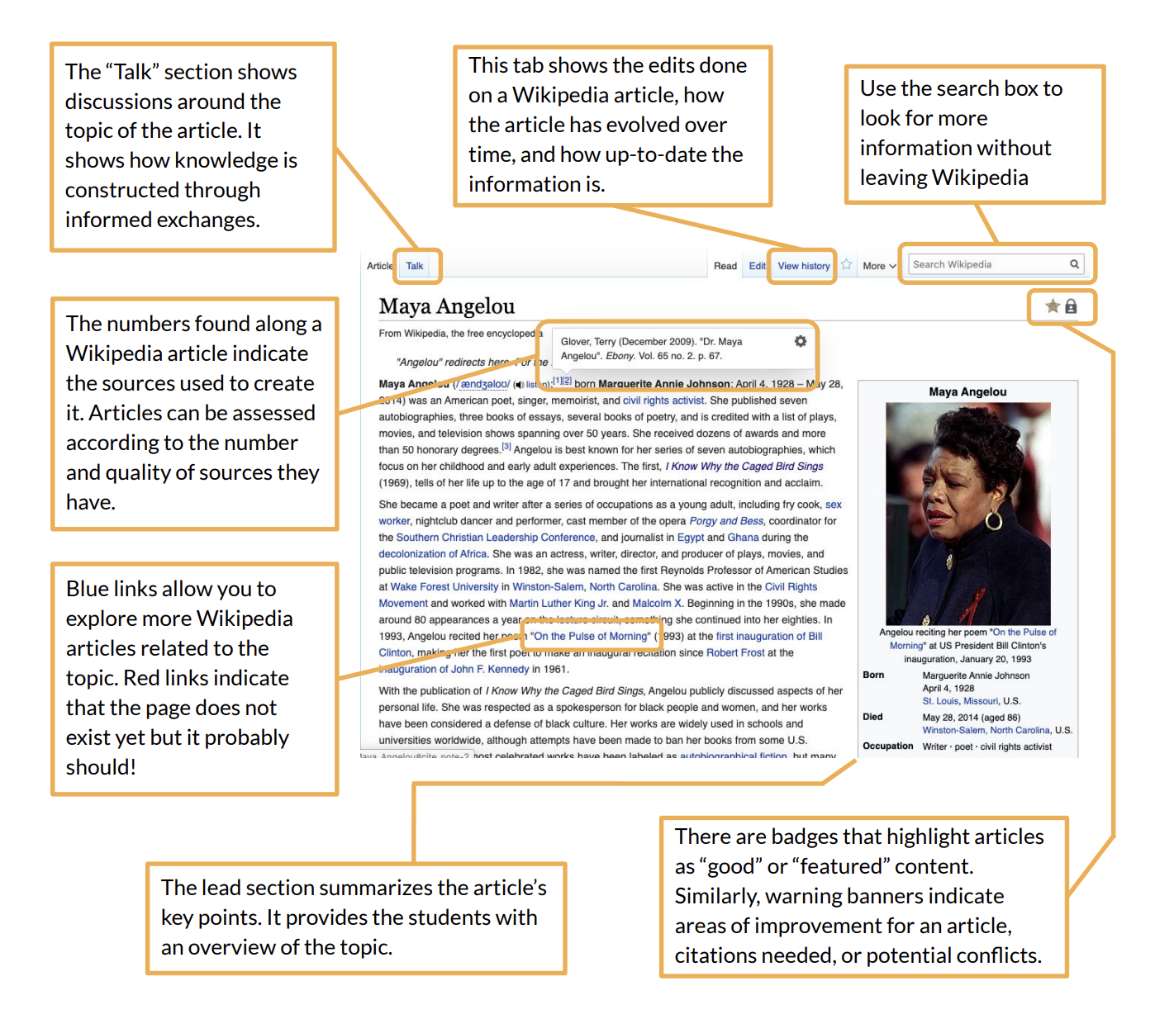

Anatomy of a Wikipedia page
Learn…

Slide 9
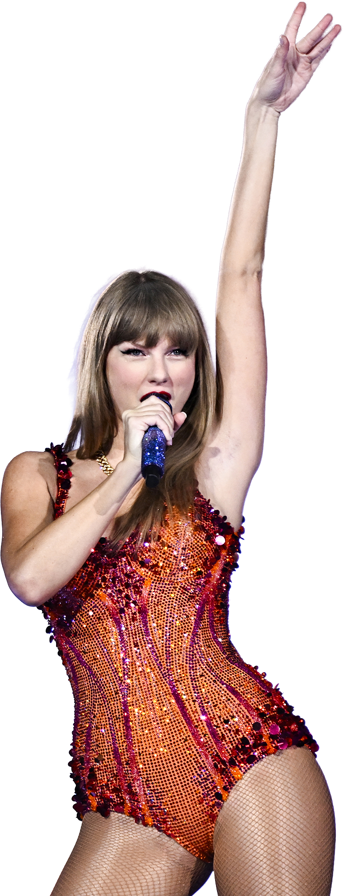
What principles does Wikipedia follow?
Learn…
Neutral Point of View:
Wikipedia is not a place for opinions, only facts. Any claims made should be ones that everyone would agree with.
For example, not everyone will agree that Taylor Swift is the best singer of her generation and is a genius. But it is an objective fact that the Eras tour was Taylor Swift’s 6th concert and was performed in 5 cities.
If there are different opinions on a topic, these different opinions will be mentioned proportionally. For example, the flat-Earth theory is not portrayed as if it is equally supported as the view that the Earth is round. Take a look at the start of the Wikipedia page Flat Earth to see how this is done.

Slide 10
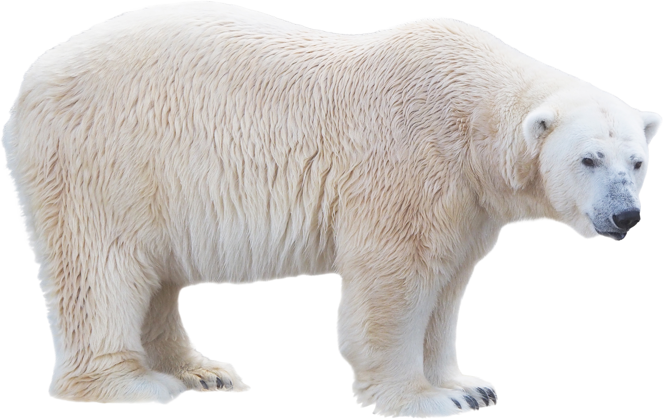
What is a neutral point of view?
Apply…
Rewrite the following paragraph leaving only
a neutral point of view.
Polar bears are the largest living species of bear, even though they are not the scariest. They are native to the Arctic and surrounding areas. They have odd-looking paws, which are large for paddling in water and walking on ice. Polar bears are carnivorous, feeding largely on seals, and their hunts are ruthless and upsetting to watch. They are a vulnerable species, with one of the biggest threats to their existence being climate change, which causes ice to melt, destroying their habitat. Polar bears typically give birth to two cubs per litter, and polar bear cubs are helpless at birth, known as altricial. They are also incredibly cute.

Slide 11


What principles does Wikipedia follow?
Learn…
Reliable Sources:
Wikipedia pages strive for reliable sources. This allows others to verify the information you are including, as they can find the sources for themselves.
Good sources are independent, known for neutrality and fact-checking.

Slide 12

What is a reliable source?
Learn…
Would the following be a reliable source for an article on Covid-19?
Think about this on your own first.
Pair with another student and talk about your answers.
Share as a whole class.
A paper from The British Medical Journal
A personal blog from a first-year
medical student
A tik-tok video from a health
and wellbeing influencer
Statistics from the NHS website

Slide 13



True of false quiz?
Anyone can edit Wikipedia
True! Anyone can edit a page or even create a new one.
2) Anyone can add false information
to a Wikipedia page and it will stay
there forever.
False! Administrators are always checking for false information, unverified claims and vandalism.
3) Wikipedia will show you articles based on your previous views. It does not collect your data.
False! Wikipedia does not use algorithms. Any clicks you make to different pages are totally your own choice.
4) Wikipedia is overseen by the charity Wikimedia, and there are no commercial interests or adverts.
True! There are no adverts and no sponsorship on Wikipedia.

Slide 14





How does Wikipedia differ from other online sources of information?
Discuss…
Think about getting information from social media platforms or other sources such as ChatGPT.
What features does social media have that Wikipedia doesn’t?
What features does Wikipedia have that social media doesn’t?

Slide 15

How many did you get?
Social media is driven by algorithms which influence what you see, but Wikipedia is not. Algorithms are rules which may push certain content based on your previous views.
Social media may be sponsored and contain adverts, but Wikipedia will not.
Wikipedia only presents a neutral point of view, but social media contains opinions
and biases.
Wikipedia will use reliable sources, but social media may not.
Social media content ‘belongs’ to the creator, but no-one owns a Wikipedia article, not even the person who wrote it.

Slide 16

How can Wikipedia combat fake news?
Learn…
Misinformation:
Fake news that is not created with the intention to cause harm. It is inaccurate and misleading, but has been shared with the belief that it is true.
Disinformation:
When fake news is shared deliberately, with the knowledge that it is fake, then it is disinformation. This is often done with the intent of making people feel a certain way about a person, group of people or theory, and can incite hatred and harm.
Echochamber:
When social media only shows you one kind of content, without showing you different perspectives.

Slide 17
Wikipedia combats fake news because
Wikipedia uses reliable sources that anyone can go and check.
Wikipedia presents a neutral point of view, not someone’s opinion.
Wikipedia someone posts something false or without a reliable source, it will be taken down by administrators.
Wikipedia does not use algorithms to present you with content, so you will not end up in an echo-chamber of narrow views.

Slide 18




Exit task
On a post-in note, write down one thing about Wikipedia that you didn’t know before.
Stick it
to the wall
before you leave!

