Slide 1

Making the case

Slide 2

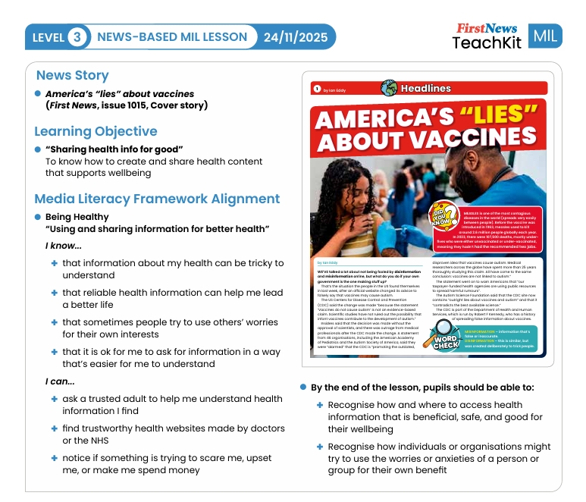

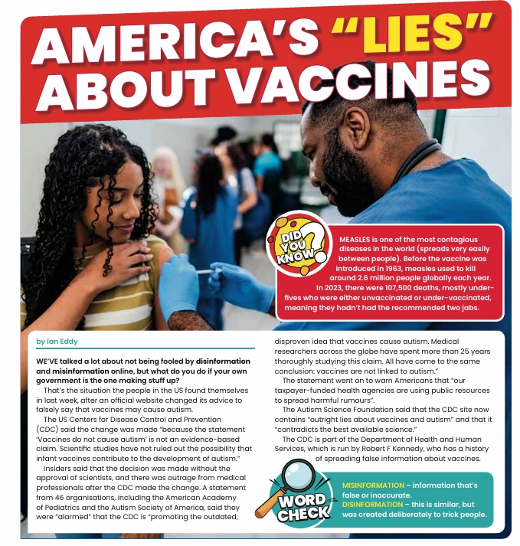

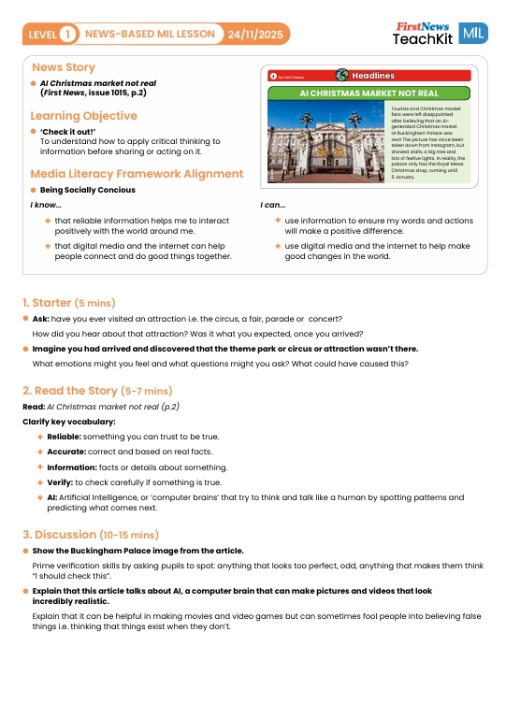


What is media literacy?
Media and information literacy (MIL) is the ability to access, understand, evaluate and create information across different formats – from books and newspapers to social media, streaming platforms and AI-generated content.
What is fake news?
Where can I get good information from?
How can I trust anything in 2025?

Slide 3

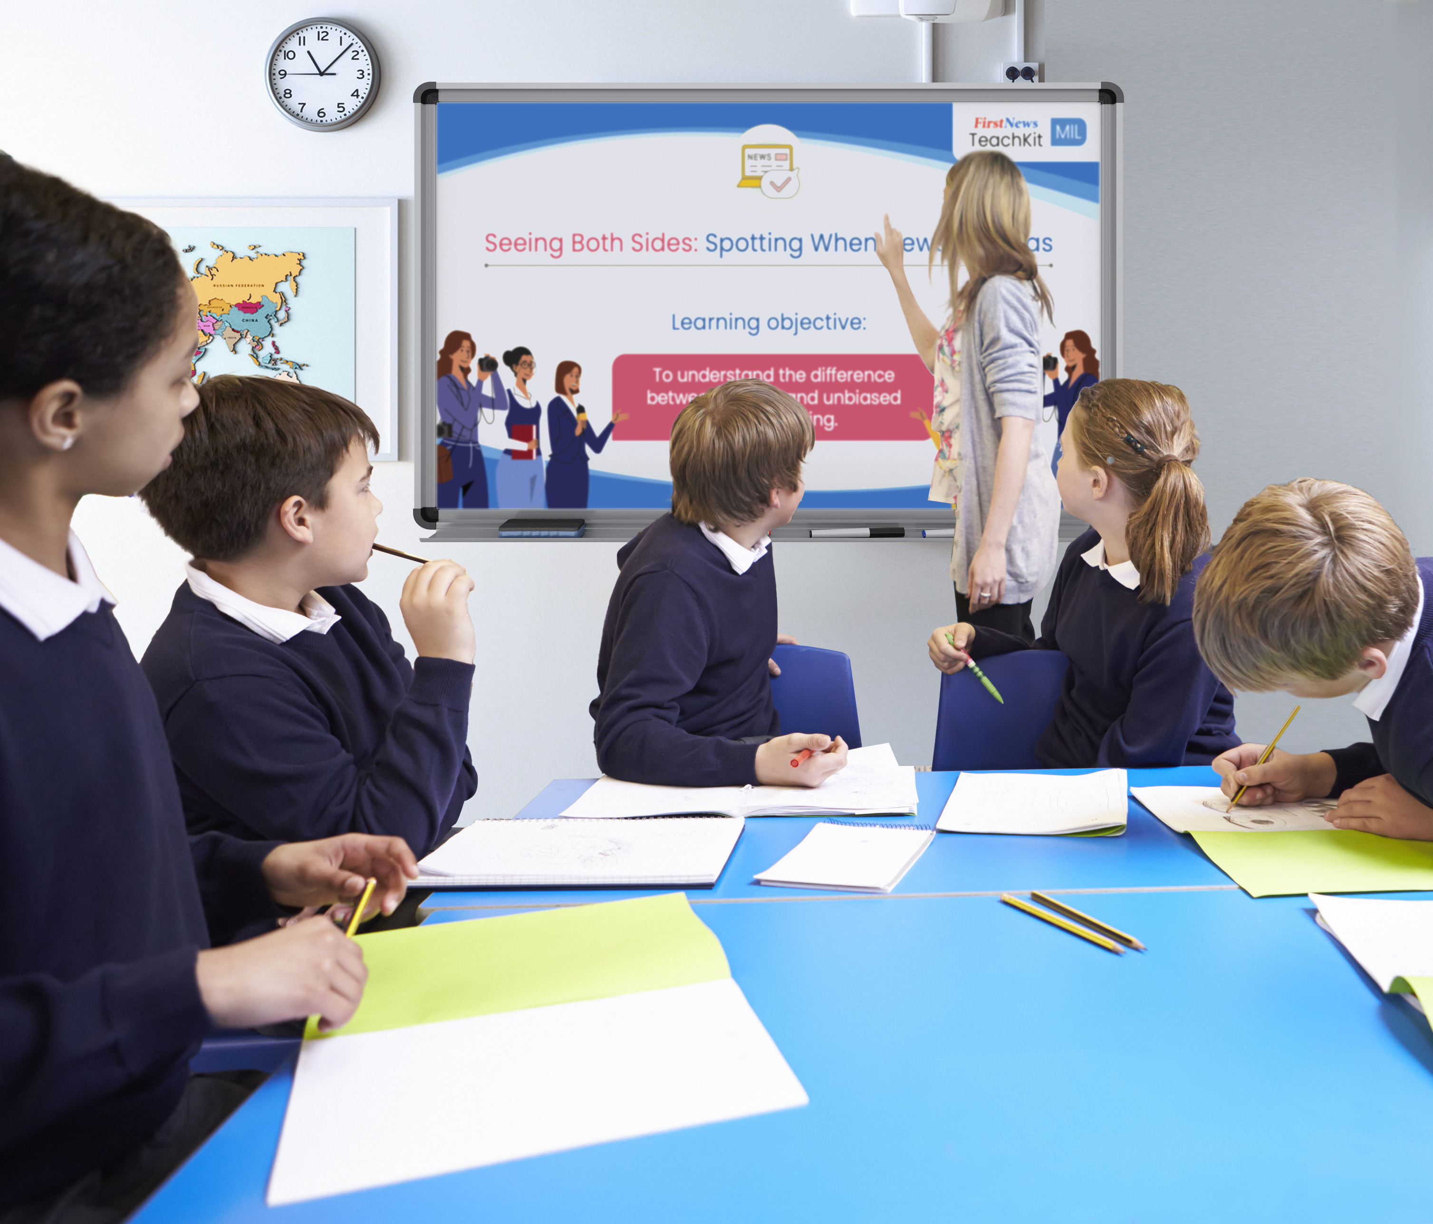
Why media literacy deserves its place in our school
Children are surrounded by vast, polarised information.
We cannot expect children to naturally know how to navigate this.
Technology and news evolve faster than the curriculum.
Media literacy must be taught to give children a strong base to confidently and critically consume and create content.

Slide 4

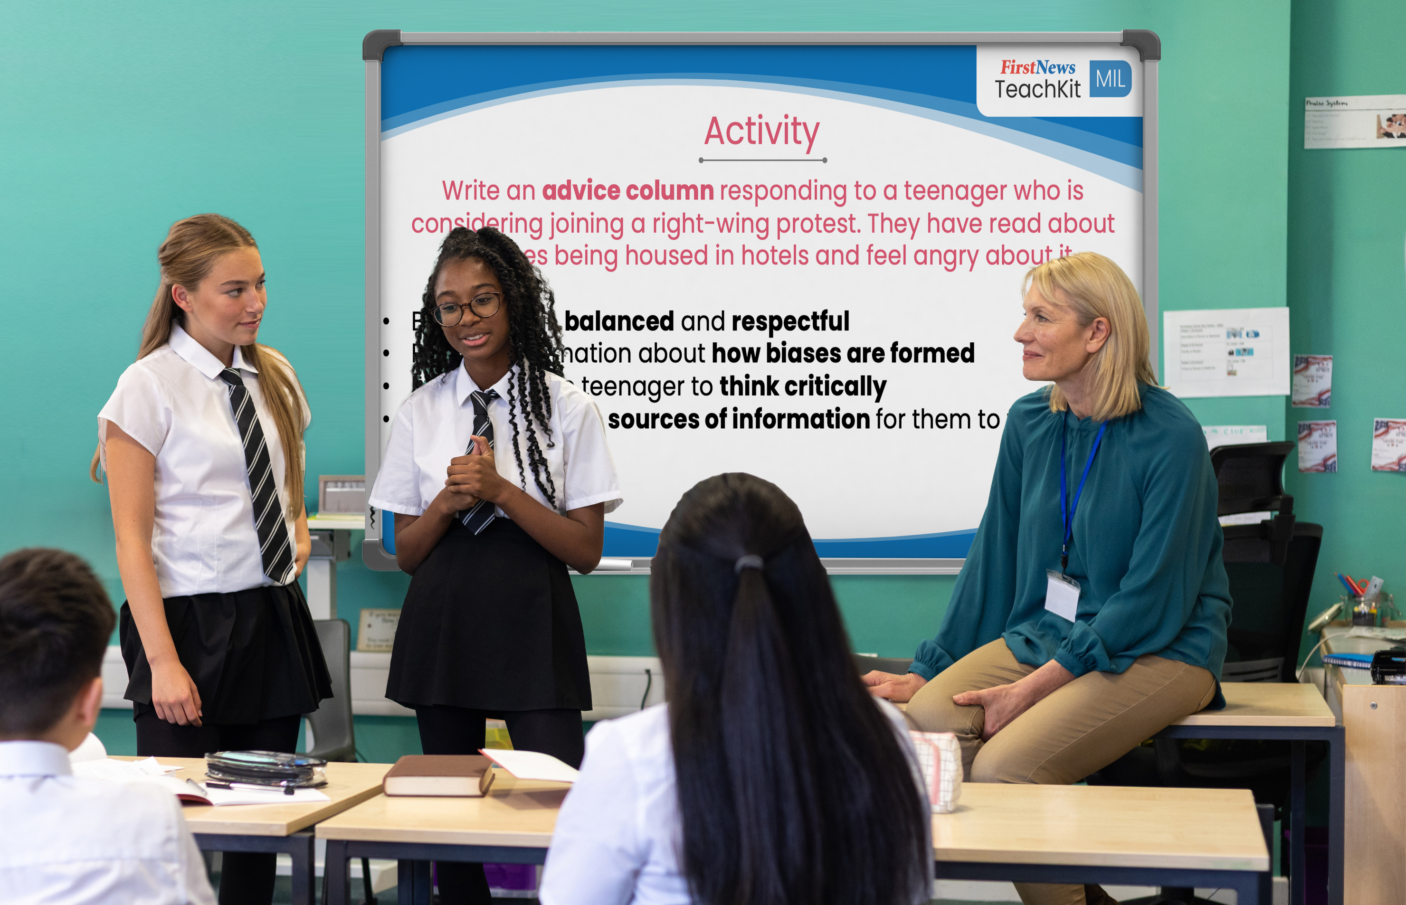
Why touching on MIL in other curriculum areas is not enough on its own
The challenge
Inconsistent confidence among staff
Rarely covered in teacher training
No clear objectives or assessment
Easily dropped in a packed curriculum
The solution
The 2025 Curriculum Review notes the importance of media literacy across multiple core subjects.
Media literacy needs dedicated time, structure and progression

Slide 5
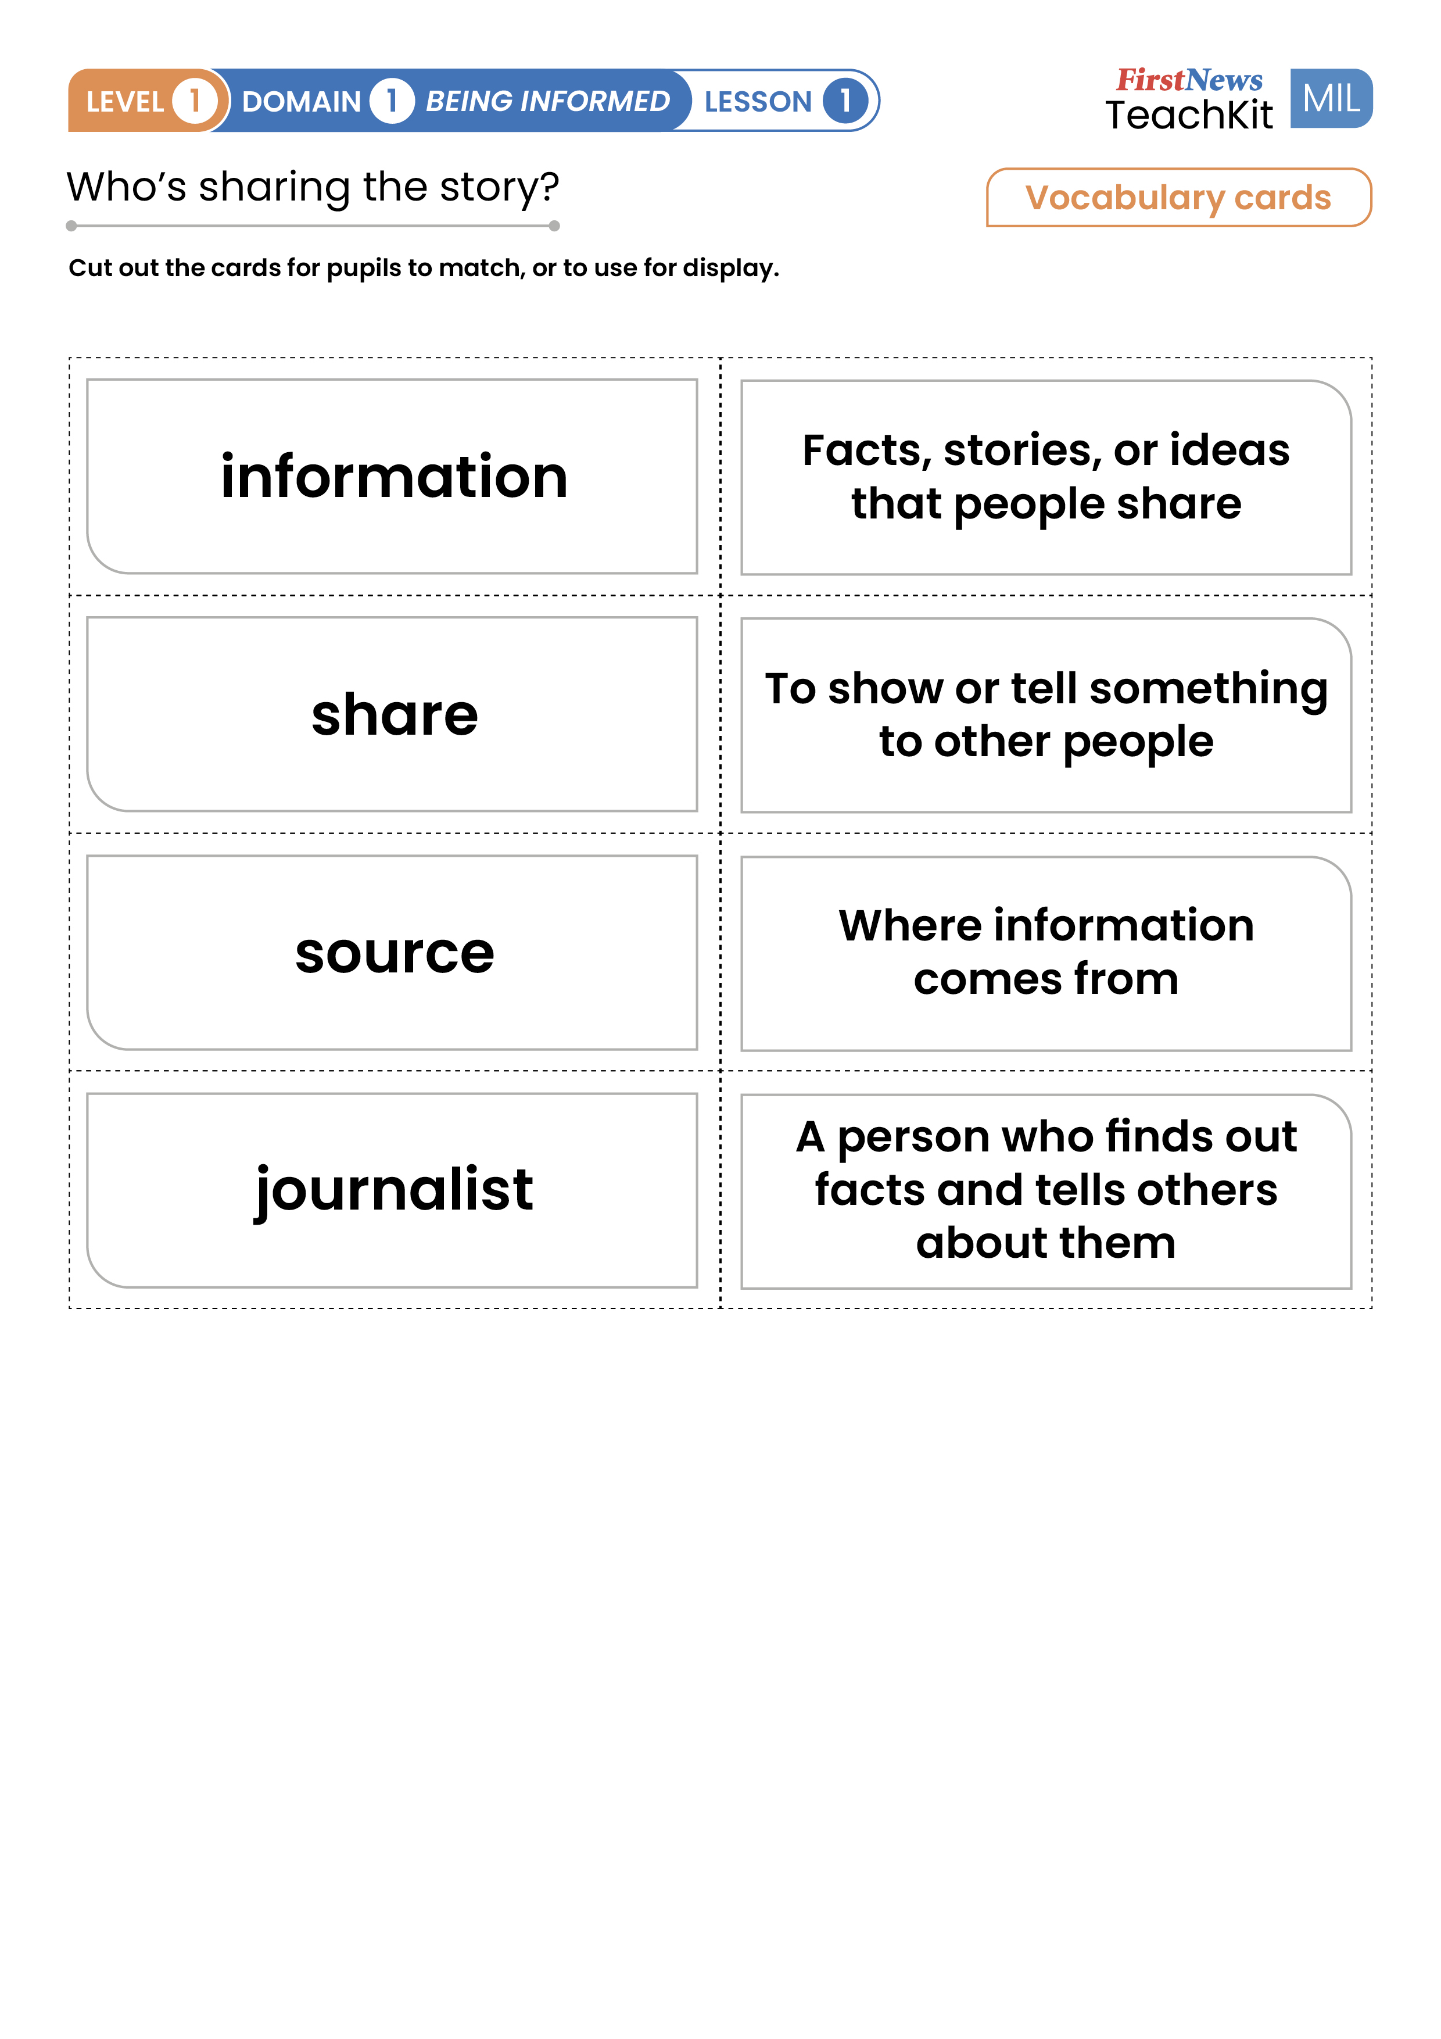
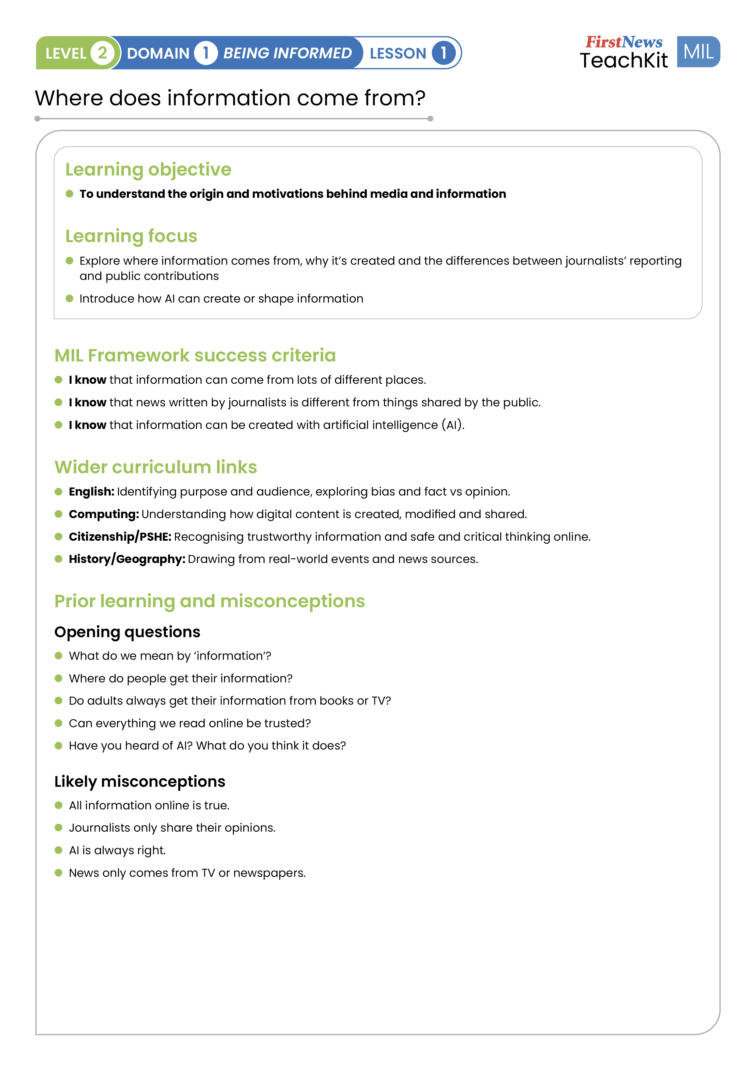
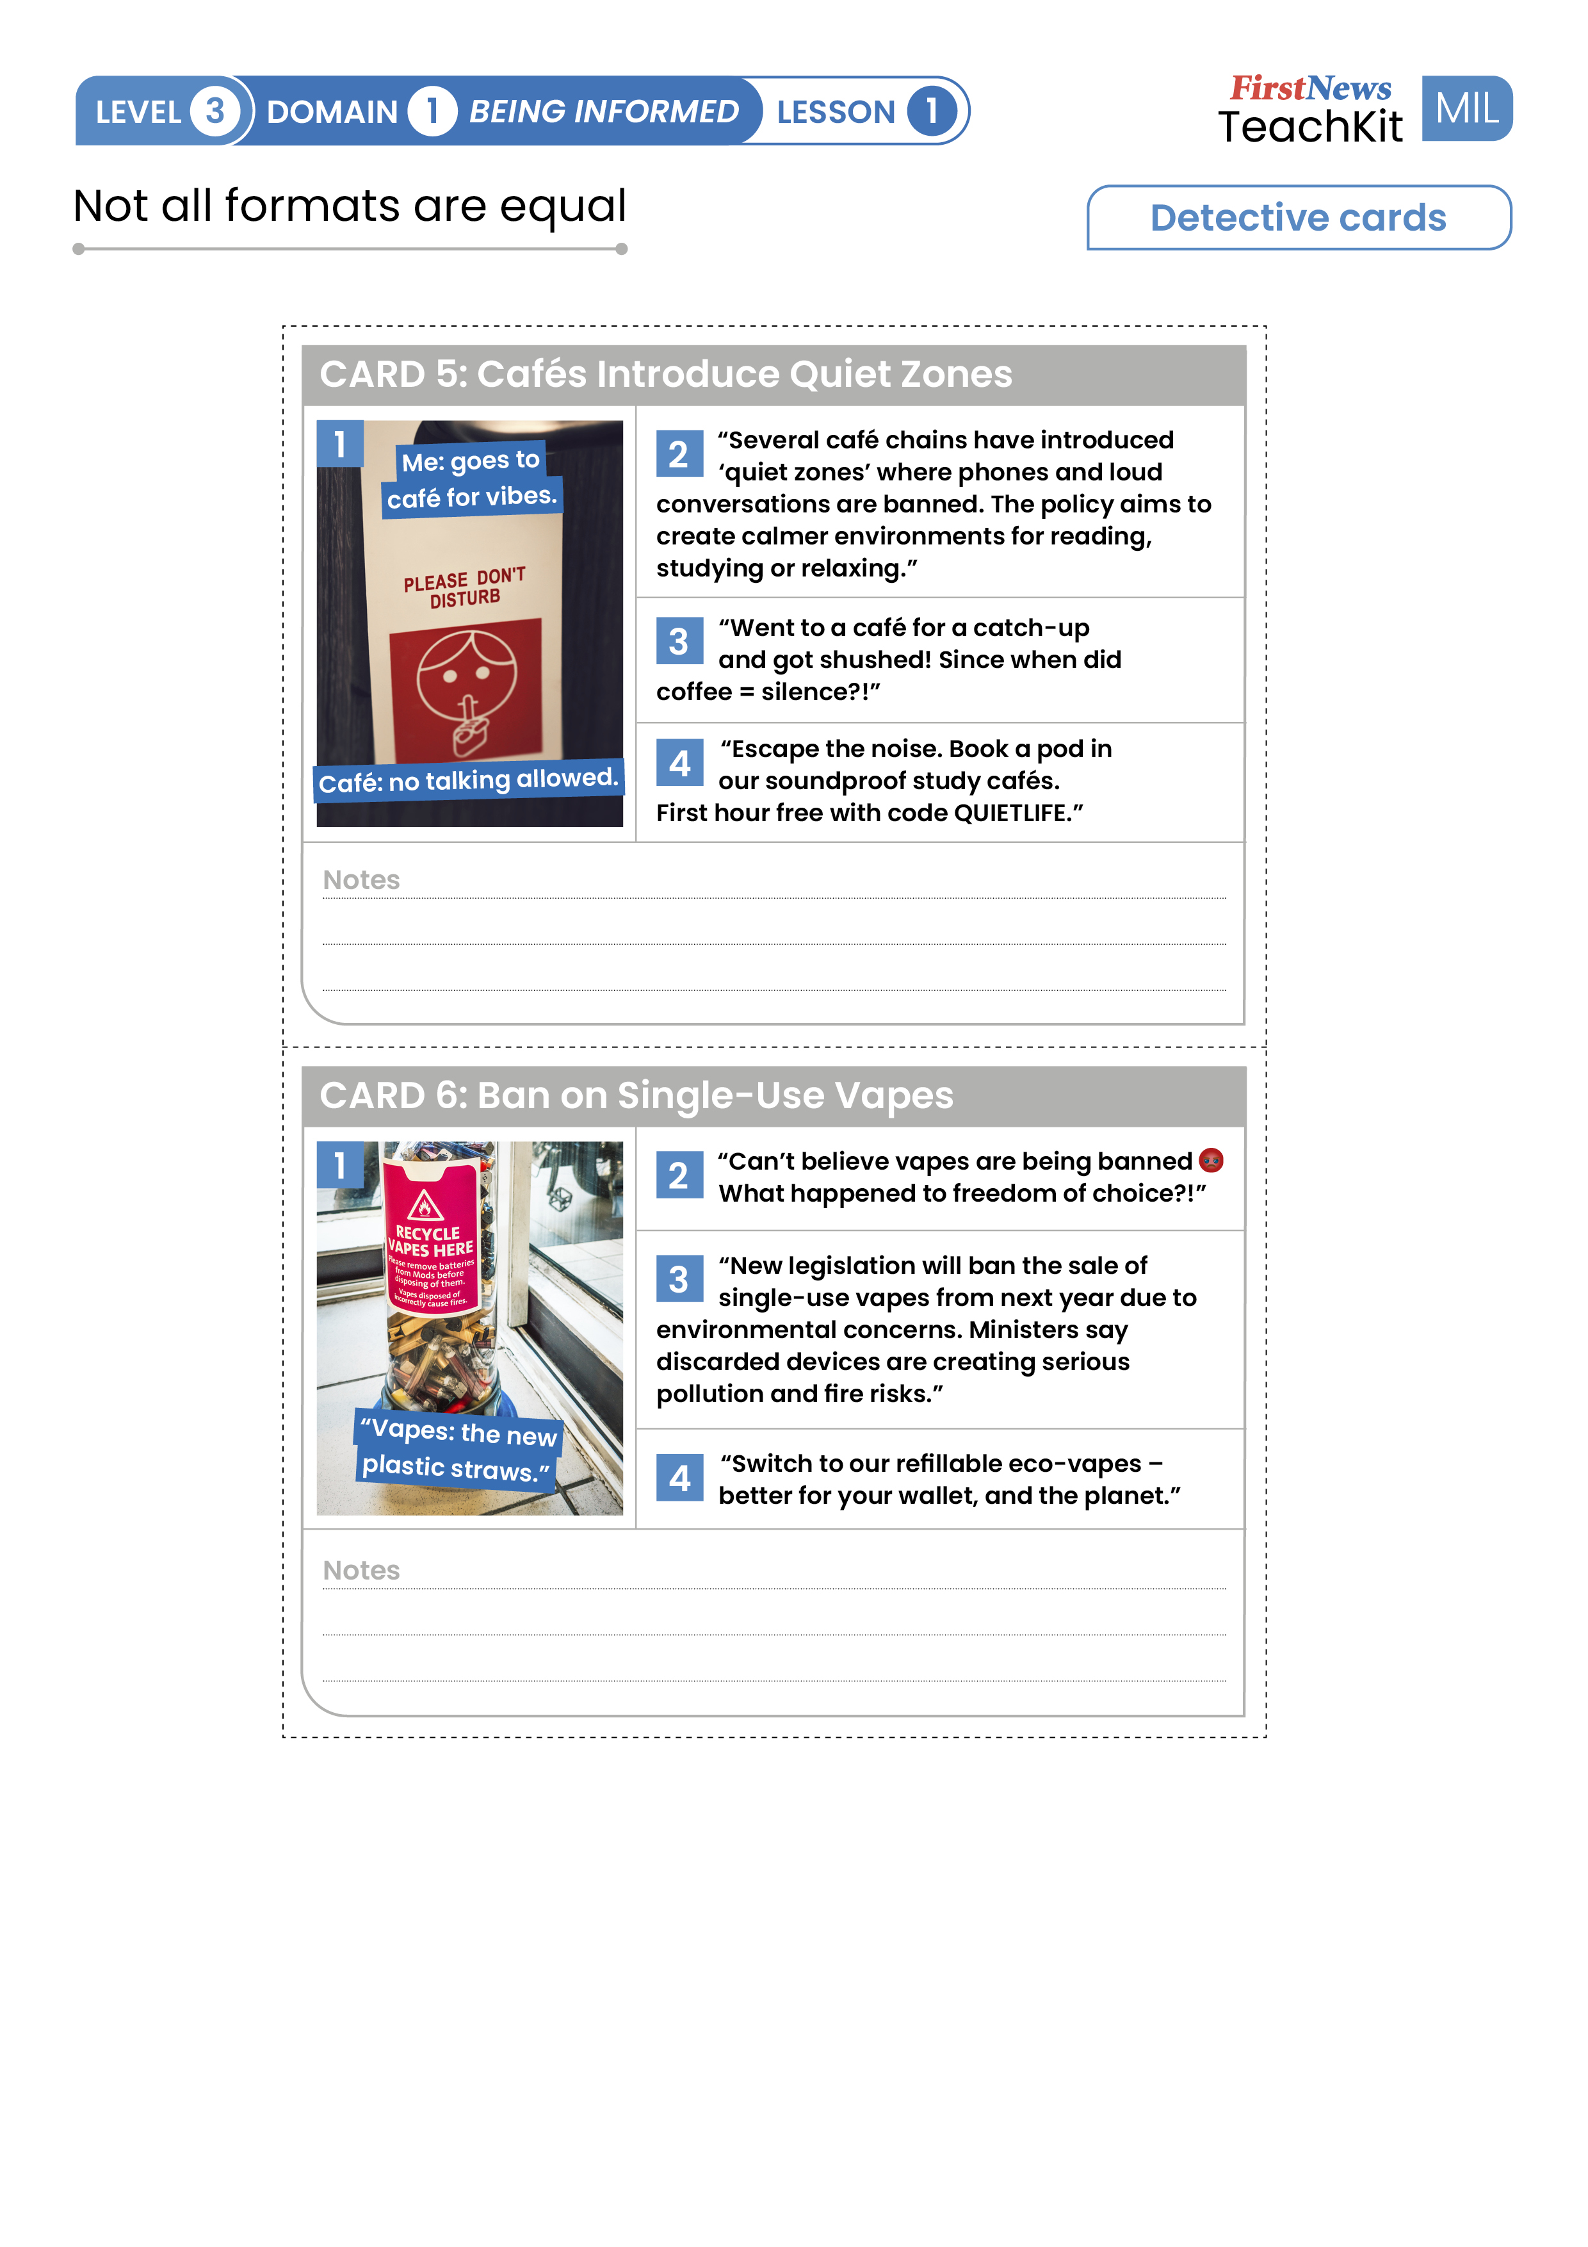
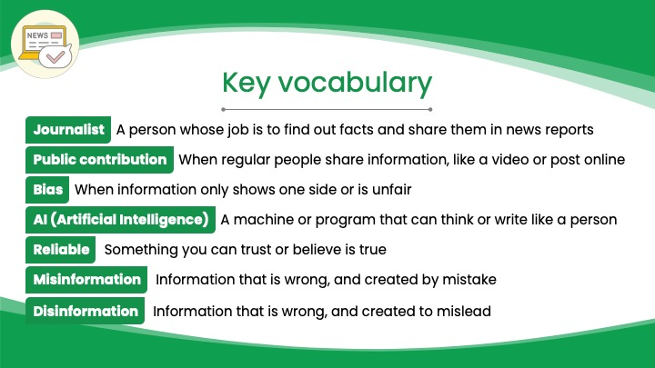
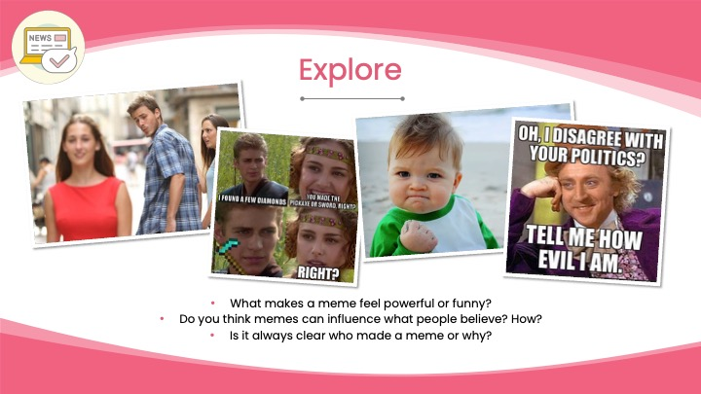
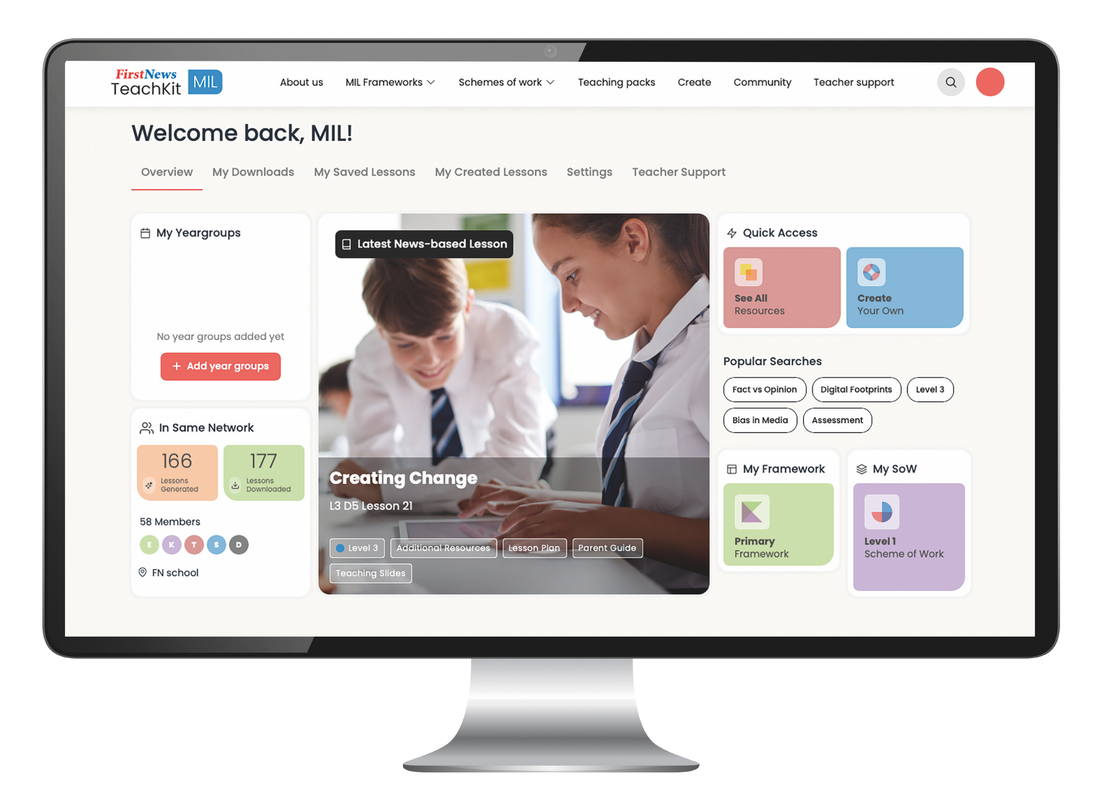
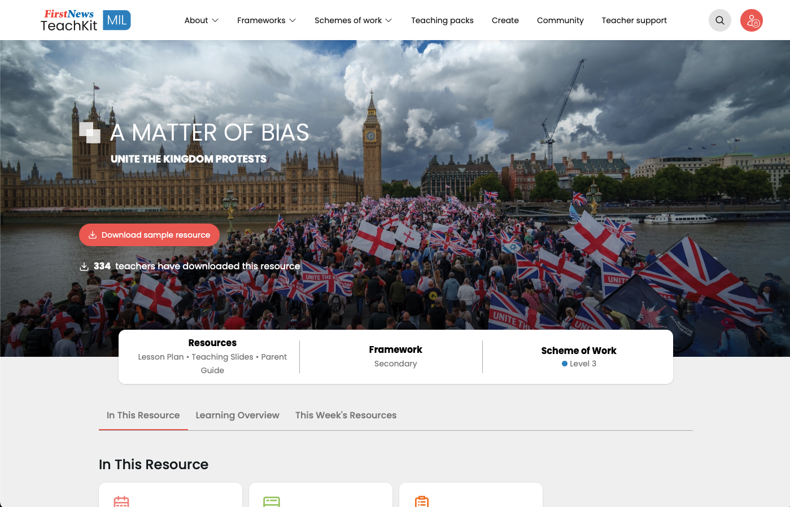
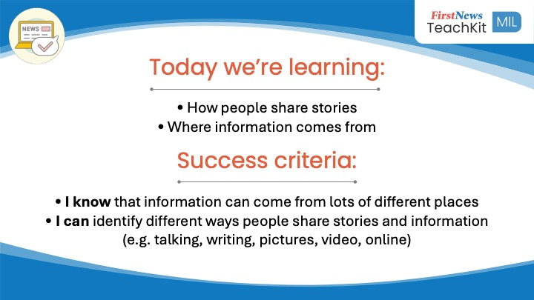
A ready-made solution!
Adaptable lessons to fit the time you have (assembly style, light touch 15-minute lessons, and 1-hour deep dives)
Progressive framework that builds skills over time
Created with MILA, the Media and Information Literacy Alliance and an expert education and editorial team at First News, the UK's leading news provider for young people.

Slide 6
The big squeeze vs dedicated MIL teaching
Hard to assess
Inconsistent delivery. Teachers are unlikely to have been taught MIL skills in their PGCE/Scitt training
Easily sidelined
Extra burden on staff
Plug and play lessons
Time-flexible formats. 15-minute, assembly, and long, deep dive lessons
Builds confidence for staff and students
Measurable progression

Slide 7
Why children need it now, not later
5
First News polls 1000’s of children every week on issues that matter to them. We are consistently concerned by a lack of media literacy in young people!
51%
57%
70%
Trust what AI chatbots say
Have been tricked online
Are worried about AI taking human jobs

Slide 8

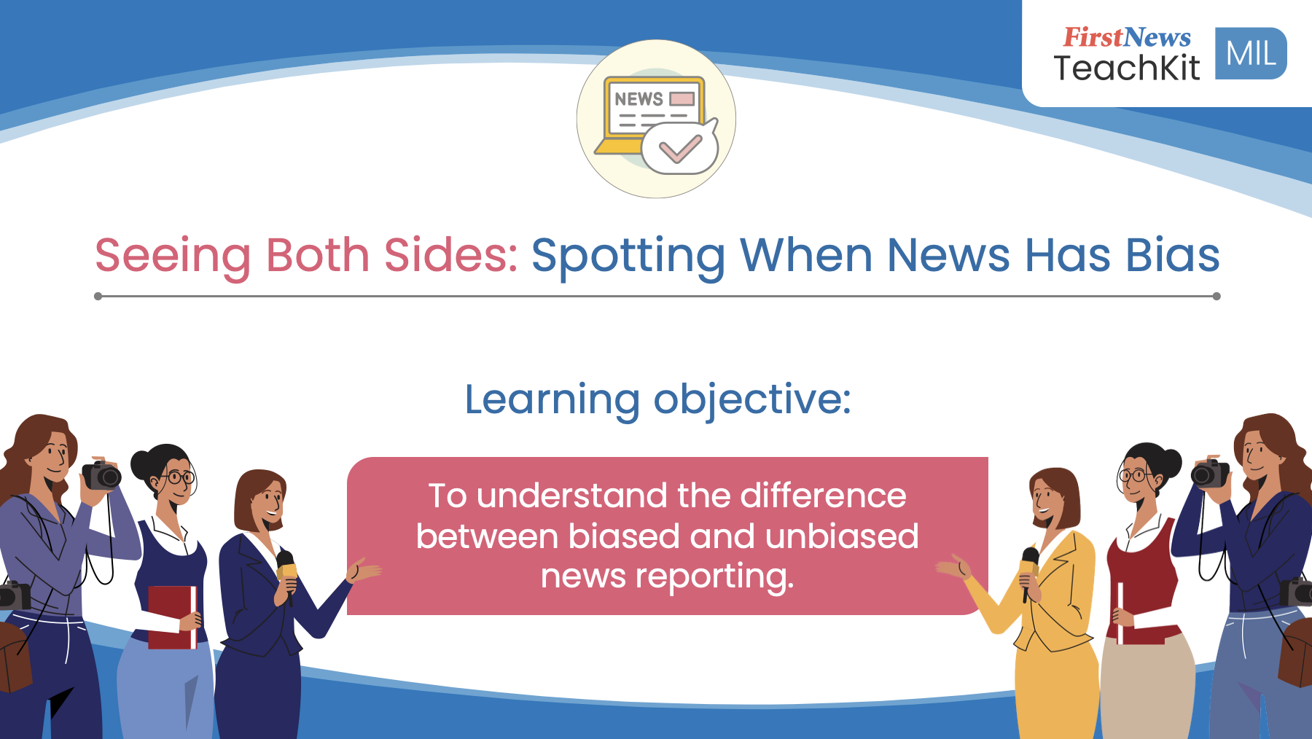

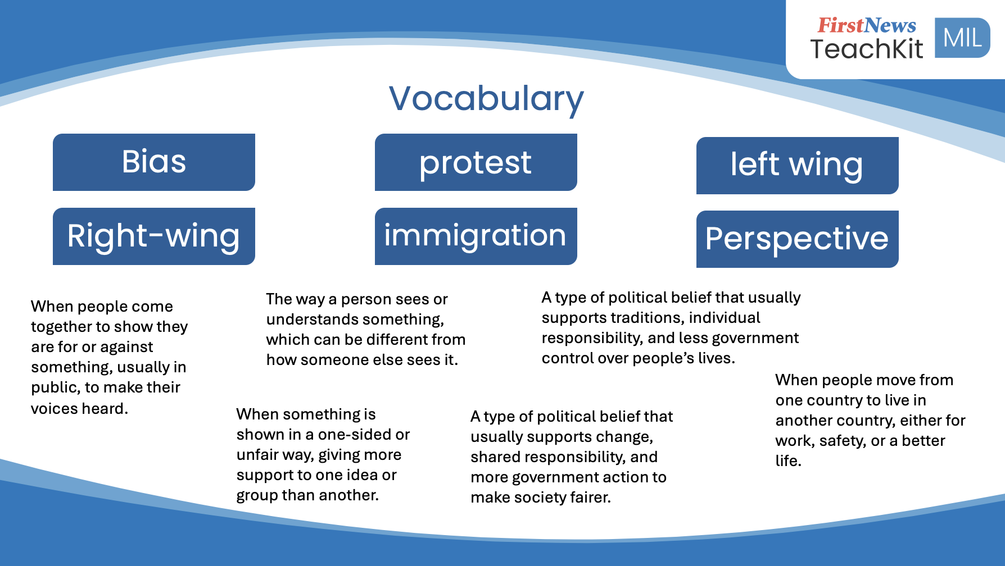

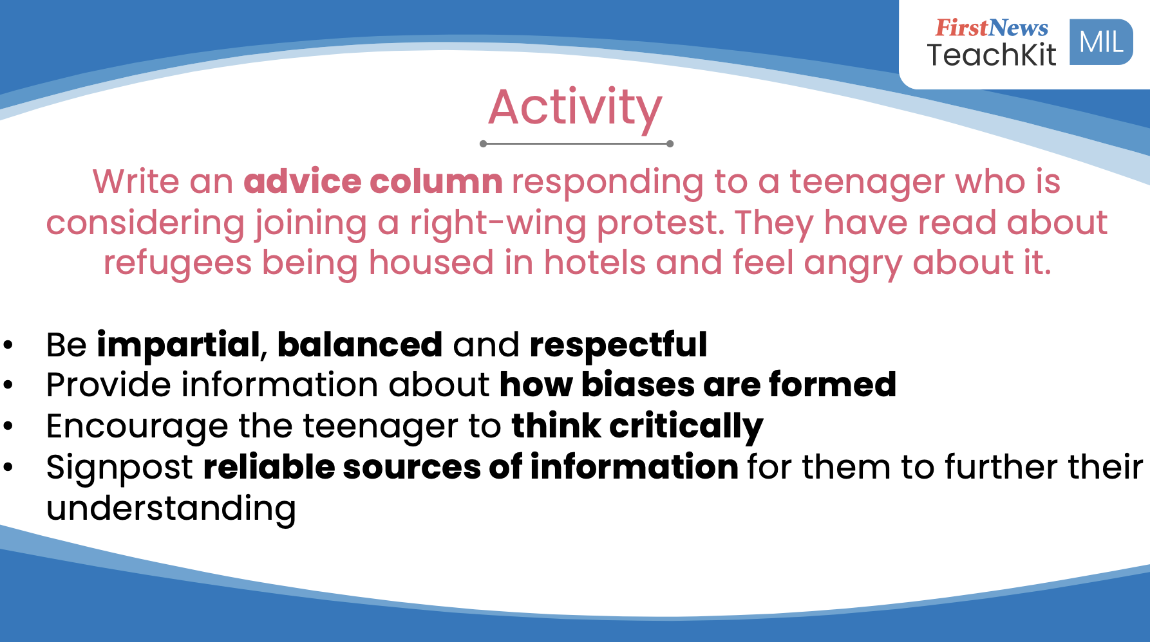
What TeachKit: Media & Information Literacy schools say
“The dynamic lesson plans, drawing on current stories and areas of interest, are a valuable and timely resource. They give teachers credible and expert guidance on how to approach what are often challenging themes.”
Standards & Effectiveness Partner, KS2, Bracknell Forest Council
“With children seeing so much online, it is vital that they are given the tools to think critically, question responsibly, and engage thoughtfully. As a Year 6 teacher and Deputy Head, I often have to tackle difficult subject areas. TeachKit is well thought through and gives guidance that even the more experienced teacher would find useful in keeping conversations on track and focused without closing down debate."
Mrs Harmer, Primary School Deputy Head
"It’s clearly very comprehensive and well thought out. It offers an off-the-shelf spiralled curriculum with clear objectives and links to a workable framework."
Mr Love, Secondary School teacher & SENCO

Slide 9
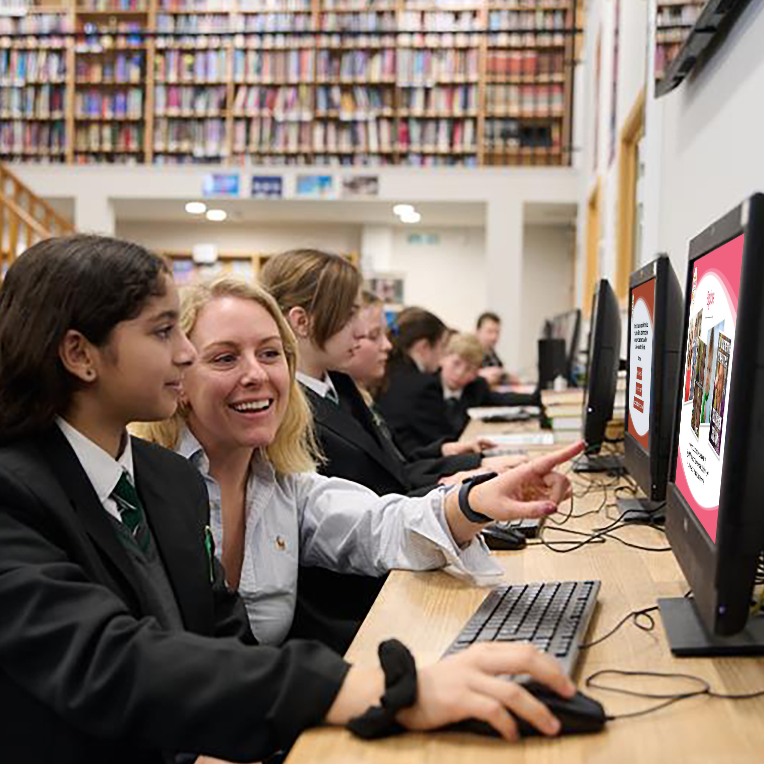
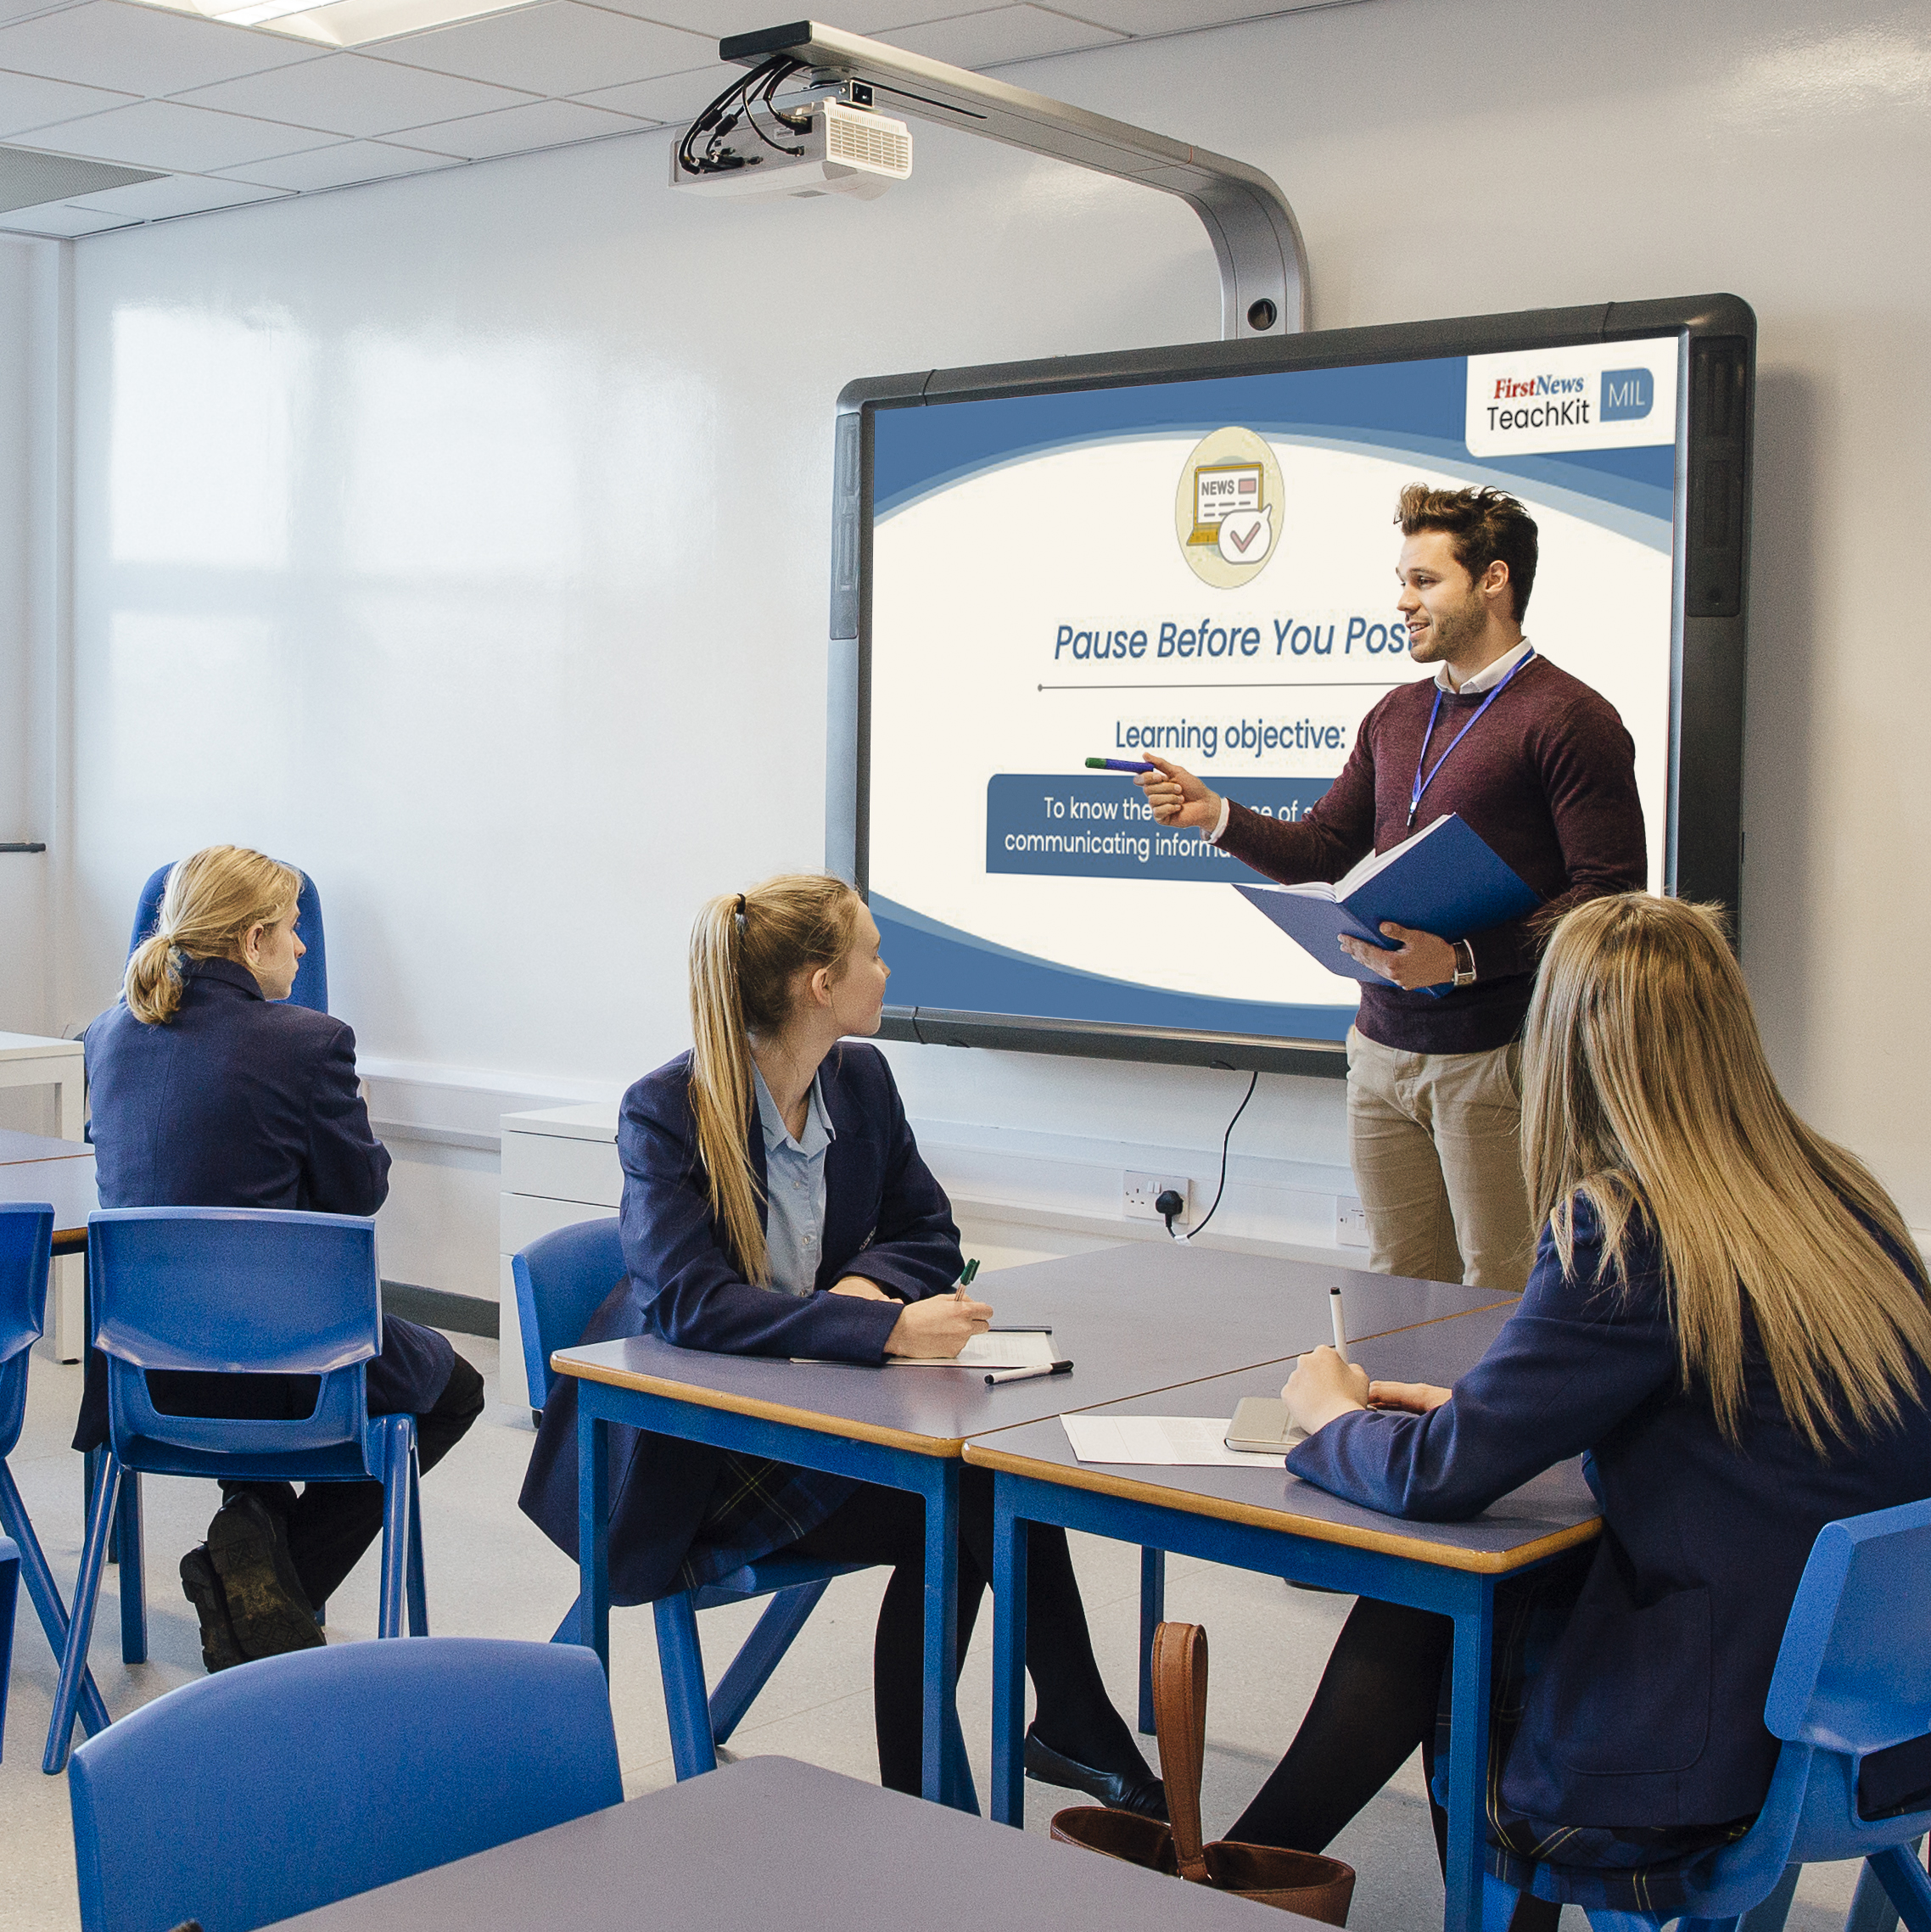
TeachKit: Media & Information Literacy
£249 for an annual subscription (or £199 if bought with any other First News product)
Frameworks produced in partnership with MILA
Fully resourced schemes of work for ages 7-14 (three levels)
Complete teaching packs for every objective
Dynamic, fortnightly lessons linked to current news stories
AI tools to adapt resources and support classroom needs
School-wide access and individual teacher dashboards
Training opportunities and ongoing support
Community-created lessons ready for download
​
www.firstnews.co.uk/mil
education@firstnews.co.uk

